Slide 1
Notes:
Picture from: https://www.sparkfun.com/products/9190

Slide 2
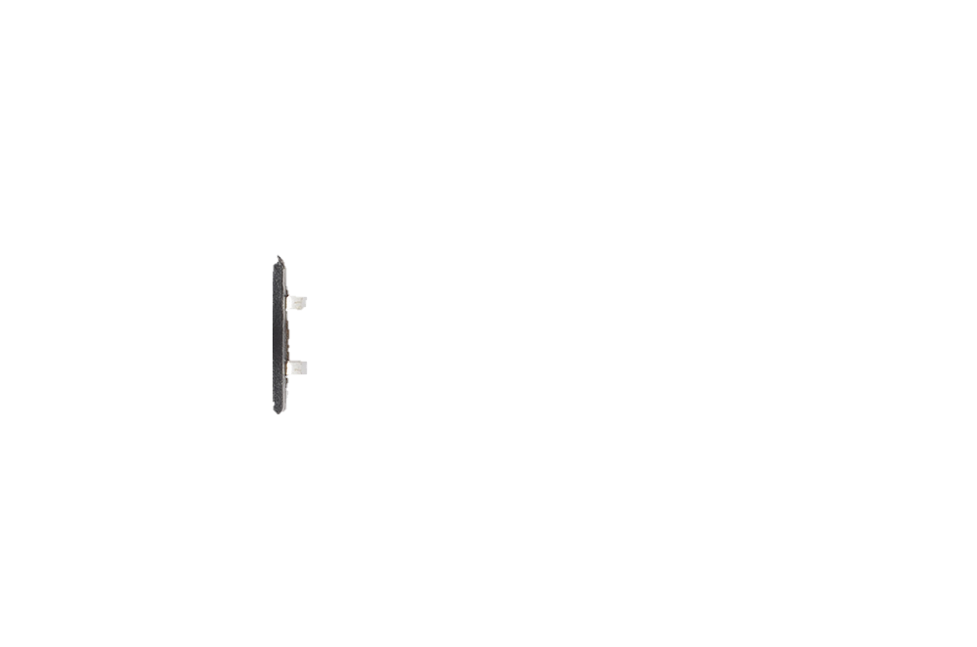
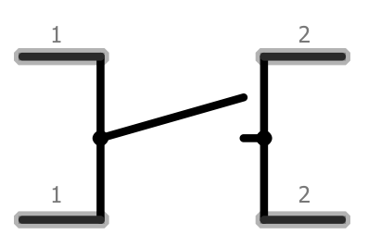
Notes:
Picture from: https://www.sparkfun.com/products/9190

Slide 3

Notes:
Picture from: https://www.sparkfun.com/products/9190

Slide 4
Notes:
Picture from: https://www.sparkfun.com/products/9190

Slide 5
Notes:
Picture from: https://www.sparkfun.com/products/9190

Slide 6
Notes:
Picture from: https://www.sparkfun.com/products/9190

Slide 7
Connected
Connected
Connected
Connected
Notes:
Picture from: https://www.sparkfun.com/products/9190

Slide 8
Connected
Connected
Connected
Connected
Notes:
Picture from: https://www.sparkfun.com/products/9190

Slide 9
Connected
Connected
Connected
Connected
Button pressed!
Notes:
Picture from: https://www.sparkfun.com/products/9190

Slide 10
Connected
Connected
Button pressed!
Notes:
Picture from: https://www.sparkfun.com/products/9190

Slide 11
Button pressed!
Notes:
Picture from: https://www.sparkfun.com/products/9190

